Slide 1
Terminal App T1A3
Carol North
DIABETES DIARY TRACKER
with a bonus educational quiz

Slide 2

TABLE OF CONTENTS
Terminal application, it’s features and how it’s used
The logic of the Terminal App and code
A review of the development/build process including challenges, ethical issues, favourite parts, etc

Slide 3
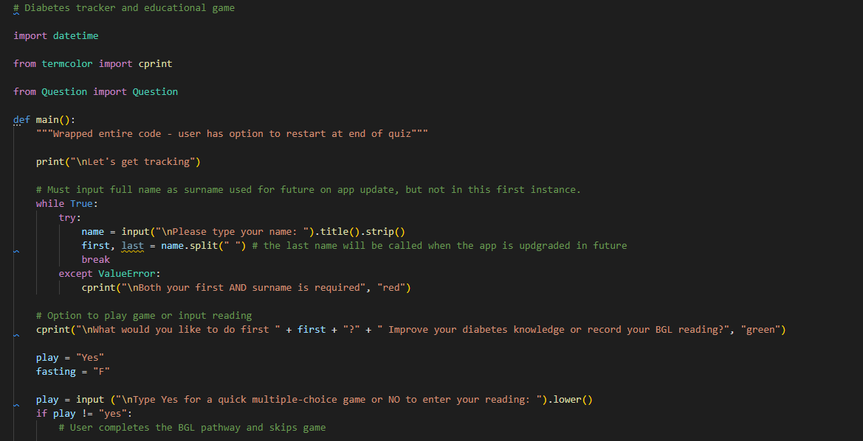
Terminal application, walkthrough
Error Handling
Notes:
I have a feature that allows the user to input their full name, and will return their first name when they are asked what they would like to do today. For error handling here I have used .title() which means it will not be case sensitive and have also included .strip() a space remover either side of their name.
The program will create a capital letter for their name regardless of what case they type in. If they only enter their first name the program will prompt them to fill in their full name before they can continue. This has an except ValueError and is contained in a while loop (with a break when both first name and surname is correctly entered)
Although only their first name is returned in this app, making it appropriately personal), the full name request is for future use, so that their name will be documented together with time/date of inputting their BGL, to share the information with their diabetes educator. The comments will alert myself or another programmer to this future fact.
The user has an option to play an education multiple choice game or go straight to entering their blood glucose level reading.
If they choose Yes, they will play the game and if they choose No they will go down the BGL pathway.
As it is still important for them to document their BGL reading, they are then also given the option at the end of the game to return to the beginning input their reading.

Slide 4
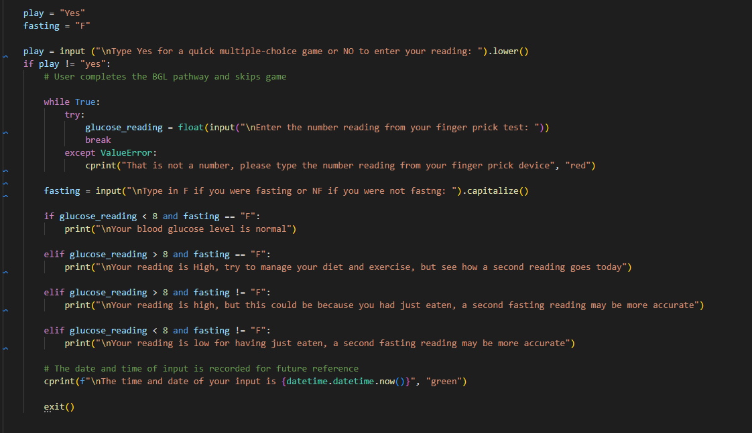
Error Handling
Notes:
This function takes a number input (expected as a possible float) from the user and uses it in an if elif statement, (conditionals) together with another user input to determine whether they were fasting or not. Based on their input, the outcome determines whether they have a high or low BGL and expresses what they should do about it. There is an exception error handing condition here that will ensure that only a number is accepted. It can be a whole number or a float. The BGL reading are usually floats so I have built this to capture that probable instance. The time and date of the input is also automatically documented/processed.
This will be a future feature of the app to gather more information regarding glucose times and levels and perhaps out put as a bar chart using matplotlib (available in Pypi.org)

Slide 5
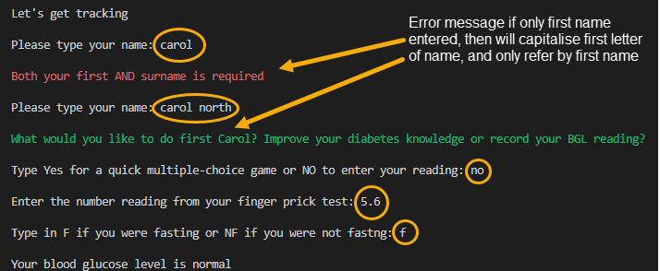
Image demonstrates that the user has taken the option of entering BGL only
Notes:
Here is the actual output that the user interacts with. I have used an imported colour terminal, as this is more user friendly and makes it easier for the user to read. Circled are the users actions.

Slide 6
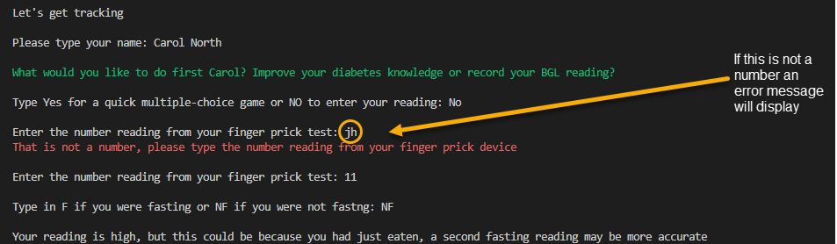
Image demonstrates that a number was not entered
Notes:
Here we can see that the user has not entered a number for their reading, and this will produce an error message, making it clear that the number needs to be the one from their device.
Also note how different readings and whether fasting or not will display different information to the user regarding the meaning of their blood glucose level, and will alert them to whether it is high or low.
This is where the program ends for the BGL entry.

Slide 7
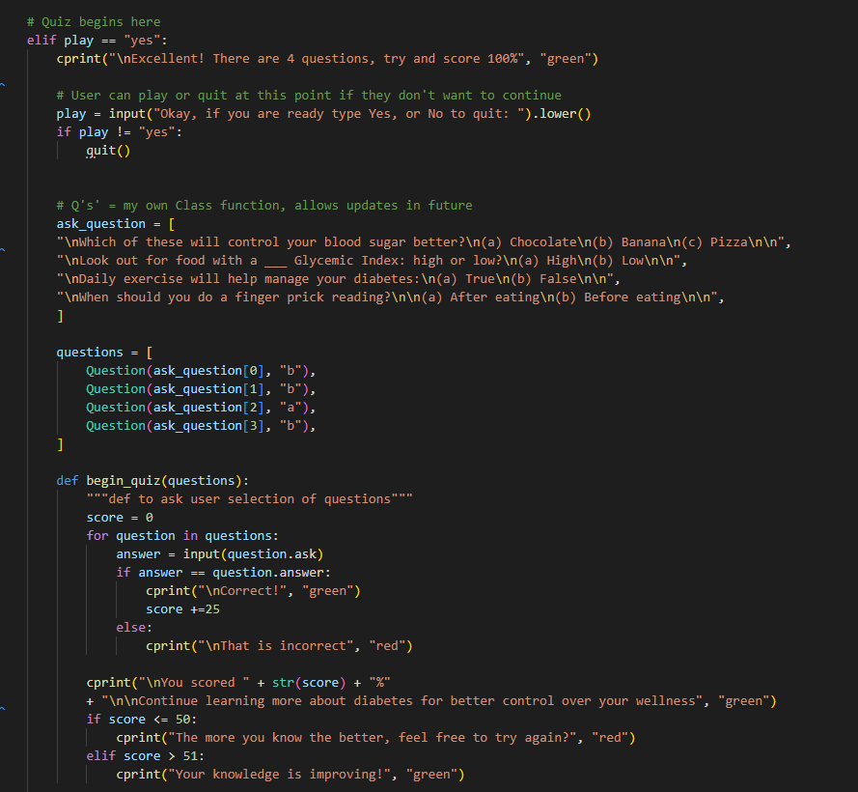
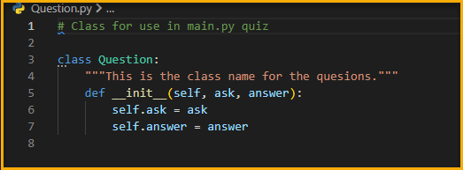
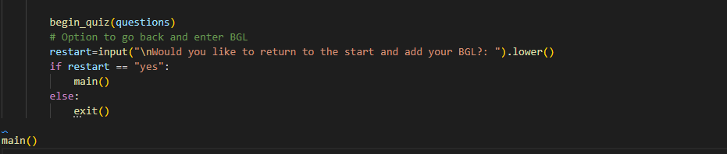
Notes:
Here is the code demonstrating the quiz section of the app. My comments alert the programmer as to where the quiz begins.
I have created a Class function for the questions and imported it into the main program to keep the code DRY.
Also, for future upgrades of the app more questions can be created/added to the Question Class function, and the ability to 'append' and 'pop' could come into play here as a list is mutable. This would allow for a different question selection each time player plays the educational game.
The quiz has a score variable which totals the final amount to determine whether they passed or not. They are given appropriate and immediate feedback based on their result and encouraged to do better. They have an option to start again.

Slide 8
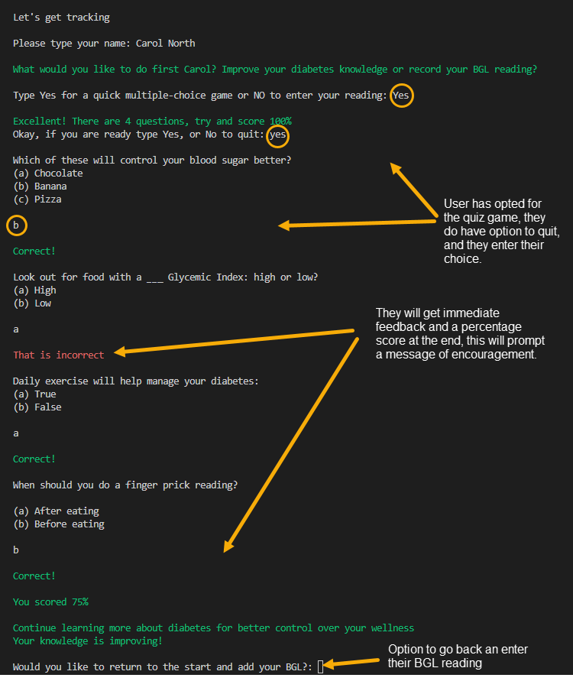
Image demonstrates that the user has taken the quiz option first.
Notes:
When the user has taken the option to do the quiz, they will follow this pathway.
Once they have chosen their answer they will get immediate feedback, and this will be scored at the end of the game as a percentage, together with a message of encouragement.
The colour terminal lends itself well here as the green shows correct and red as incorrect.
As it is important for them to still enter their reading, at the end of this section they will be given the option of going back to the beginning and entering do so.

Slide 9
The logic
Two pathways:
  enter a BGL reading and
  Complete a knowledge quiz (with option to enter BGL reading afterwards)
Error handling essential for app functionality:
  User name input and BGL reading input. It was crucial to get the name correct as well as the receiving a number entry and therefore In used while loops which would continue until the condition was met.
Notes:
Two pathways for the app:
Enter a BGL reading and
Complete a knowledge quiz (with option to enter BGL reading afterwards)
For error handling:
It was crucial to get the user name input and BGL reading correct otherwise the app would crash. Therefore I used while loops which would continue until the condition was met.

Slide 10
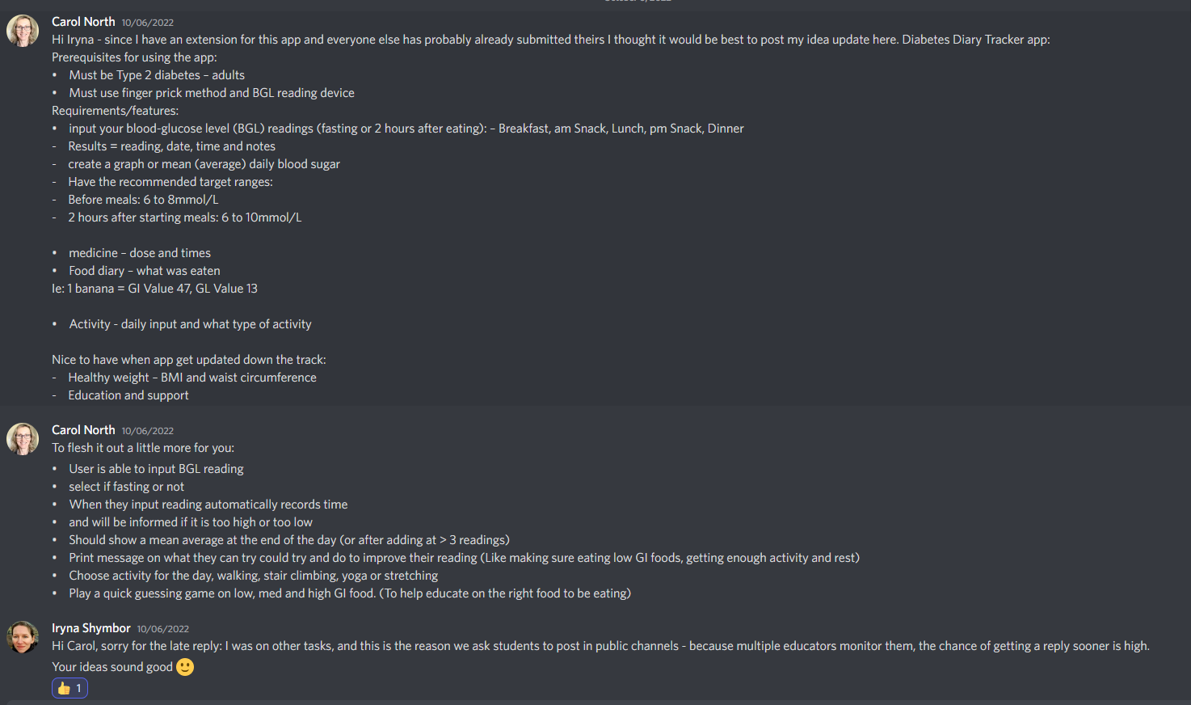
Began the process by getting ideas for my app by looking at official diabetes websites for correct information and received approval from Iryna Shymbor for my idea.
A review of the development/build process
Started designing flowchart (it had a number of changes until I felt there was a logical working function
Notes:
I began the process by getting ideas for my app by looking at official diabetes websites for correct information and received approval from Iryna Shymbor for my idea.

Slide 11
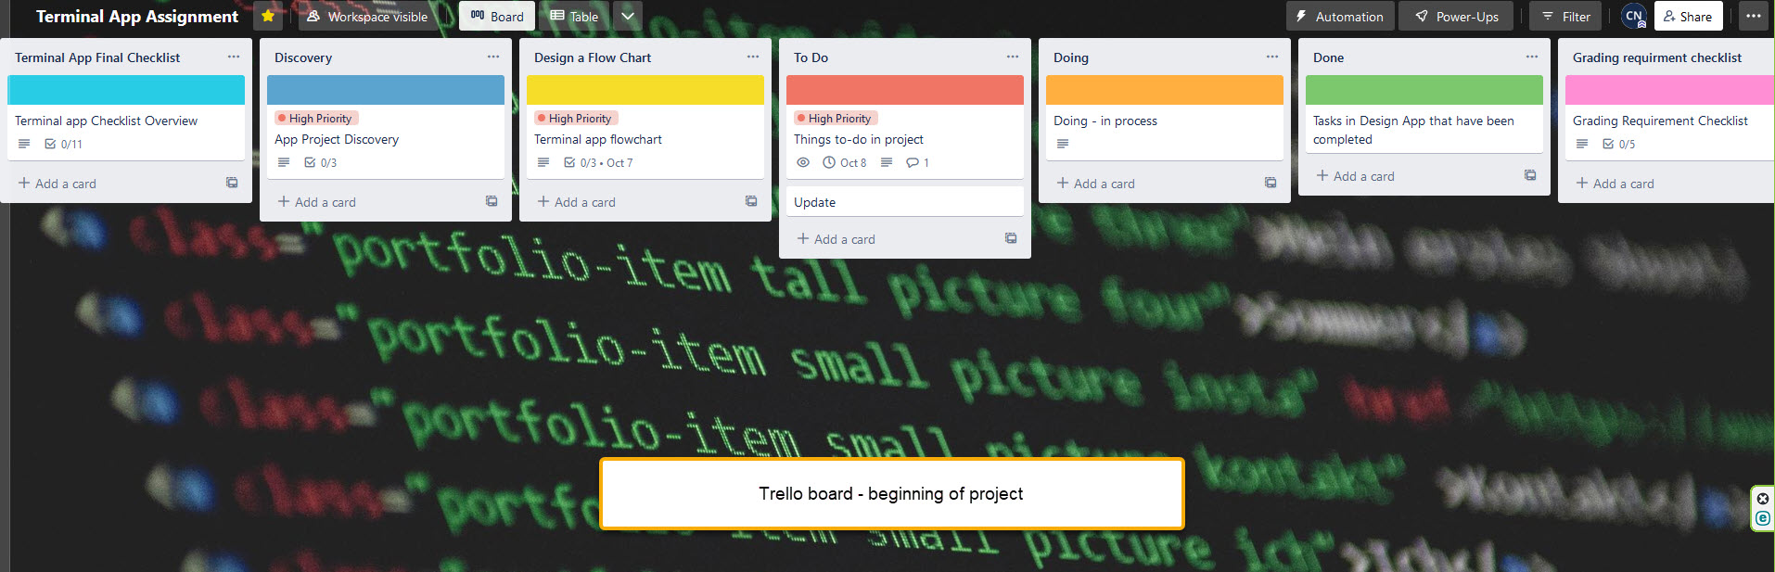
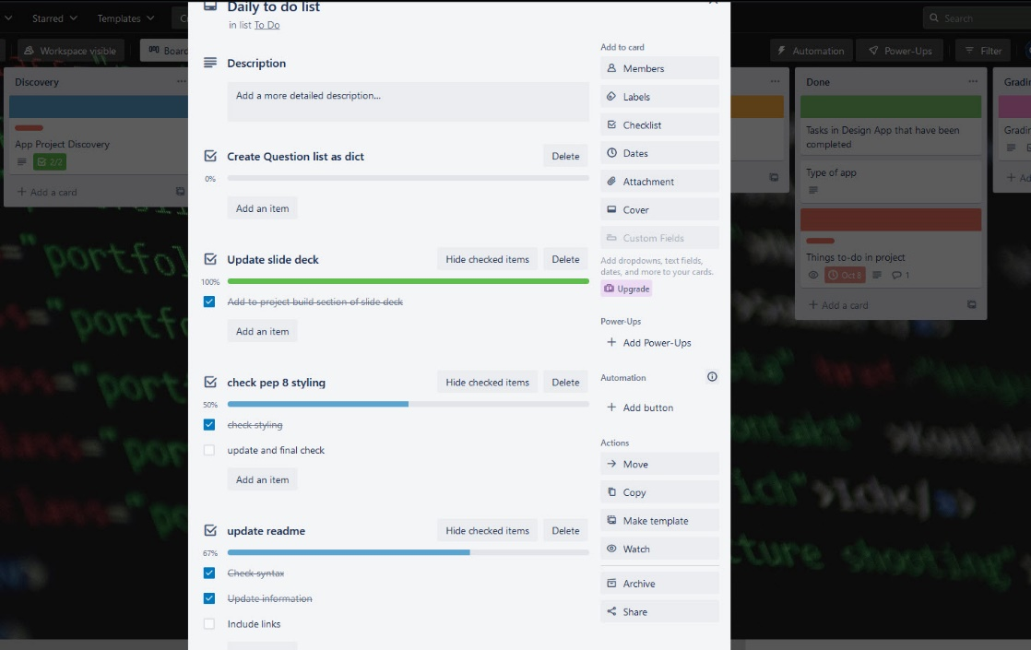
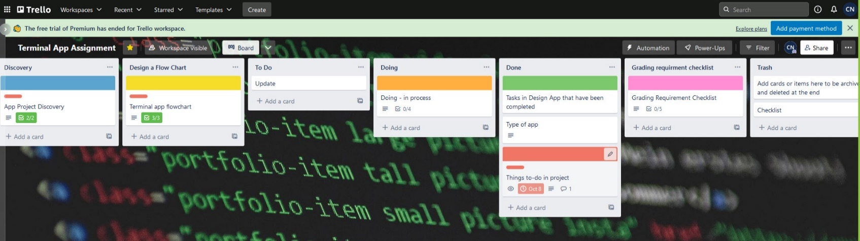
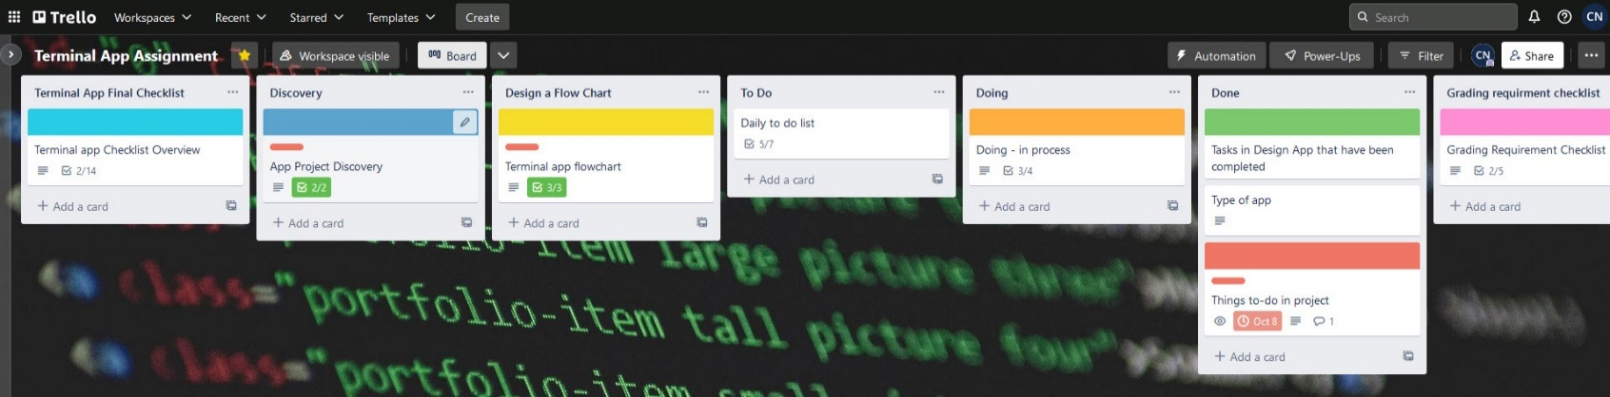
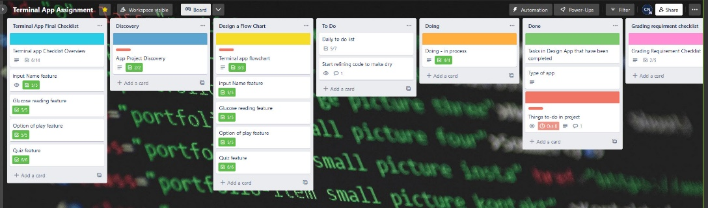
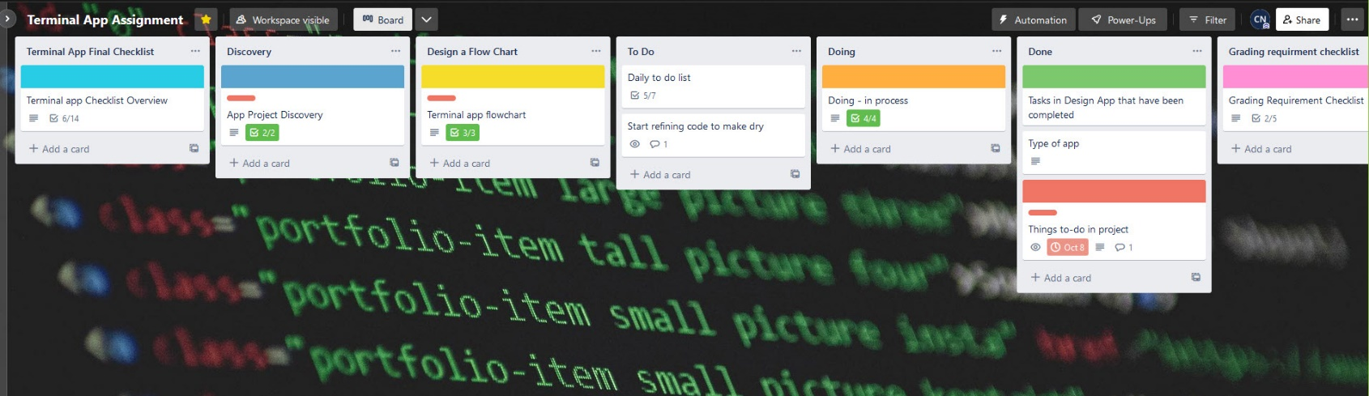
Trello board – set up and stages
Notes:
I set up my Trello board - Initially I want sure whether to include the assignment rubric rather than just the app itself – so I kind of did both.
This took some getting used to and I could have used it better, but I only saw that as I went along. I can see how very effected it can be particularly with big projects or if working with others to project manage a job. I have included some snapshot along the way.

Slide 12
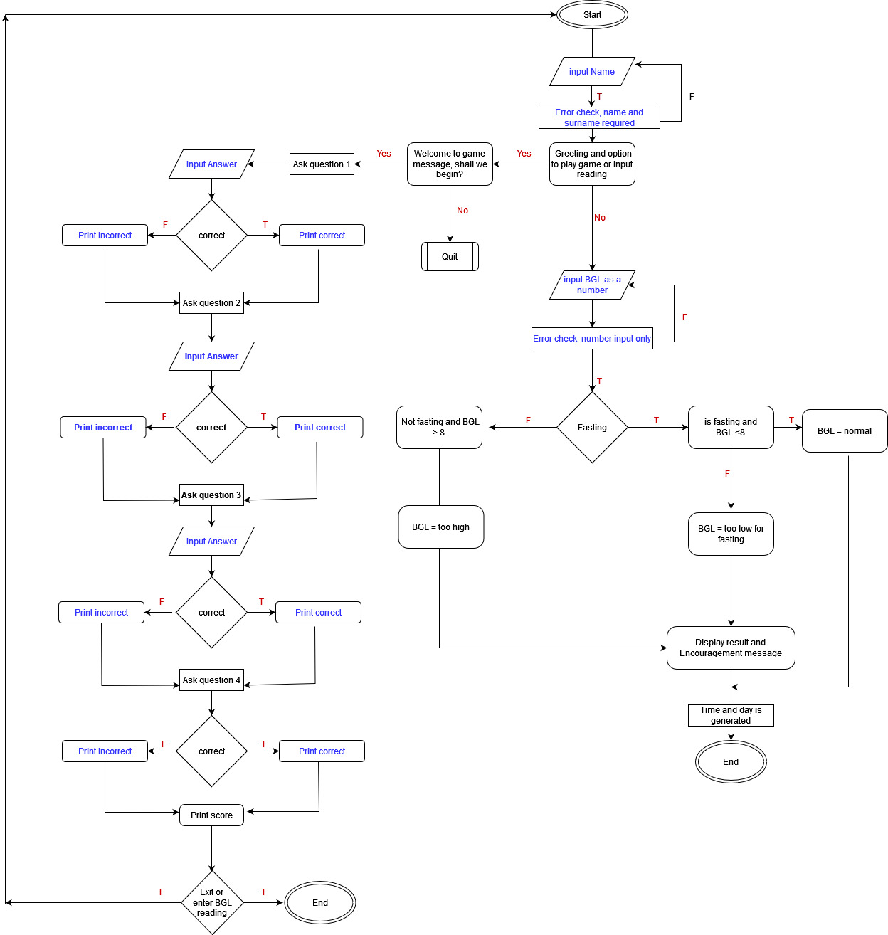
Started with pseudocode, (example below) while developing flowchart:
  # user to input name
  # If name incorrect apply error handling and ask again
  # Ask user if want to play game or enter BGL reading
  # if yes to game play game
  # else enter reading etc
Notes:
I began by writing pseudocode to try and understand how I wanted the app to flow, and then developed that thinking into as flow chart. I did change it along the way, particularly as my skill level is not at the level that I first envisaged for my app.
This has lead me to have a ‘wish list’ for future updates when I am more practiced and skilled after completing my course.
The list includes:
Creating more questions which mean that the user would get different quiz questions when opening the app again.
More blood glucose inputs for the day and then plot this with matplotlib – this will give a mean average.

Slide 13
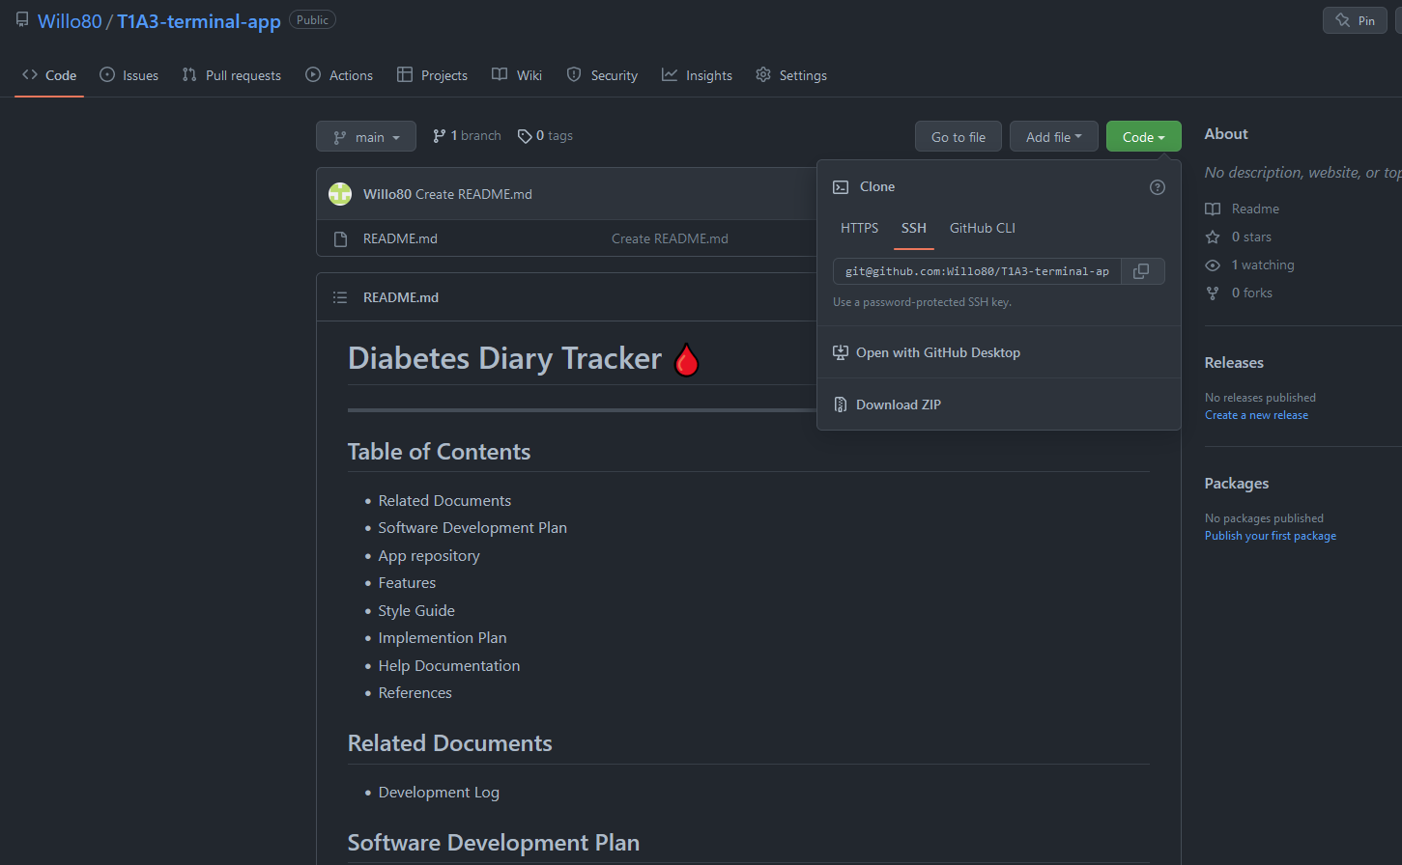
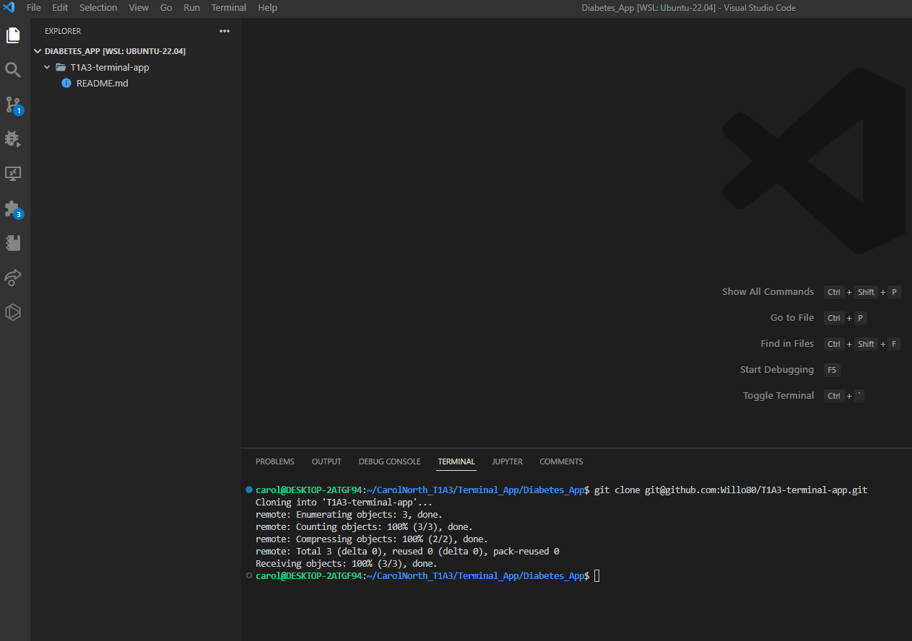
Set up repo in GitHub –added a readme file, and VS code
Notes:
I set up a GitHub repo and a created a README. File , then cloned it into VS code where I could begin my project and perform regular commits to GitHub to save my work.
– I actually had to redo this twice as I messed it up with the virtual environment… a good learning curve with all the research as to what I had done wrong.

Slide 14
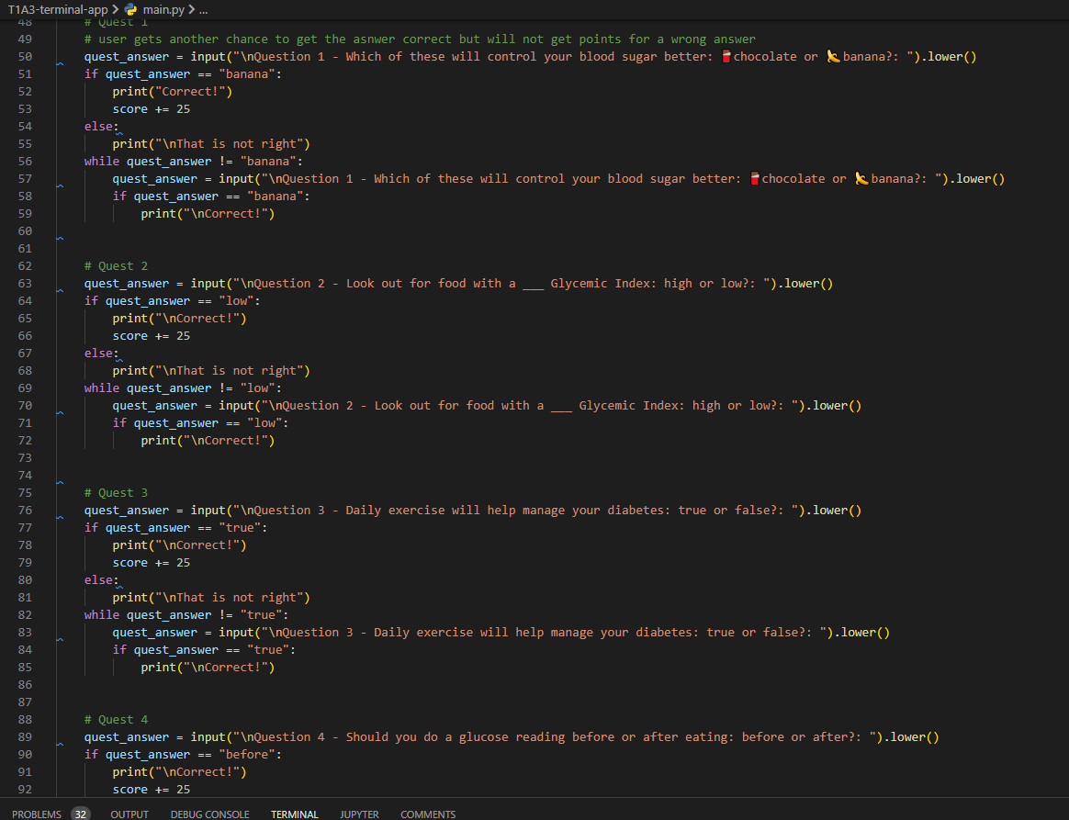
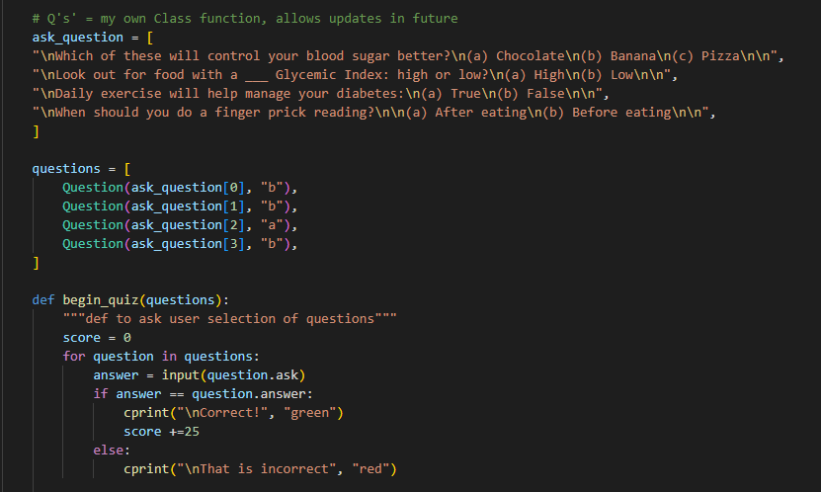
Updated code to OOP to make ‘cleaner’ more DRY
Before DRY
After DRY
Notes:
I then updated my code to be more Object-oriented to make it ‘cleaner’ , more DRY as well as making the quiz adaptable for future upgrades of the app. (For purpose of the assignment its is kept to a maximum of 4 questions, but would be a future development to make it more random/engaging/different.

Slide 15
Favourite Parts and Challenges
Seeing the terminal app come to life
Importing the colour terminal to make it pop.
Getting the functions to work effectivity was both a challenge and a joy
GitHub proved challenging in the beginning (with the VENV)
Notes:
I really enjoyed creating this app, especially importing the colour terminal and giving it life. I look forward to my future coding skills. There was definitely a good learning curve with this development and it really out the learnings from the tutorials into perspective and made me really grasp and understand the how's and whys of classes, functions etc

Slide 16
END

